Slide 1
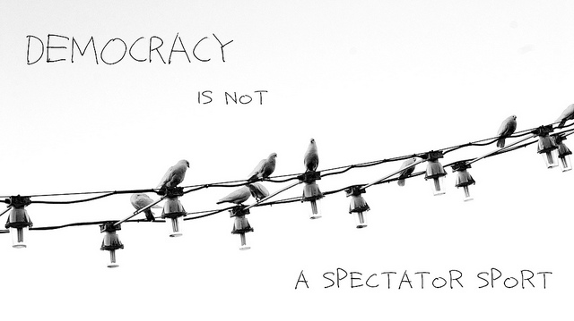
Democracy in Brief
Democracy in Brief slides by Janni Aragon.
CC BY
“Democracy” by SUXSIEQ. CC BY-NC

Slide 2
What is Democracy?
Definitions of democracy
Why democracy?
Democracy is envied, and it’s hard work

Slide 3
The Enlightenment
Enlightenment Ideals
French Philosophers
Responses to Enlightenment ideals

Slide 4
Political Theorists
John Locke, Jean-Jacques Rousseau, & Mary Wollstonecraft
Iris Marion Young, James Tully, Tai Alfred, Cornel West, and Carole Pateman

Slide 5
Challenges and Promises of Democracy
Challenges of democracy
  Hard to maintain
  Imprecise
Promises of democracy

Slide 6
Democracy and Freedom
Freedom of the Press
Freedom of Assembly
Freedom of Religion
Freedom to cast a vote in free regular elections

Slide 7
Democracy and Institutions
Executive
Legislative
Judiciary
There are checks & balances between different institutions in most democracies.

Slide 8
Checks and Balances
Legislative Branch makes laws
Executive executes laws
Judiciary reviews laws

Slide 9
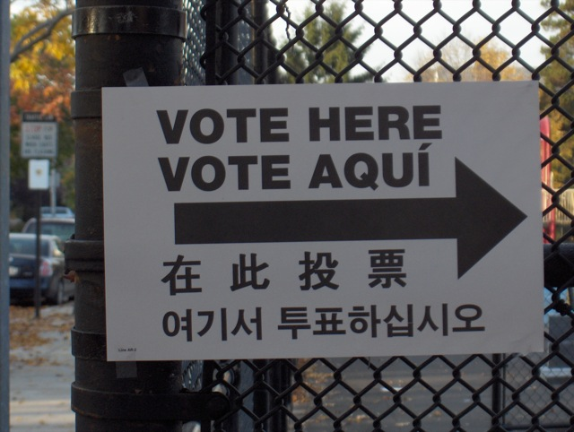
Democratic Culture
Part of democratic culture is having free, frequent elections
Political parties
Choices with voting
Image: Vote Here Vote Aquí by MyJon. CC BY-NC-SA

Slide 10
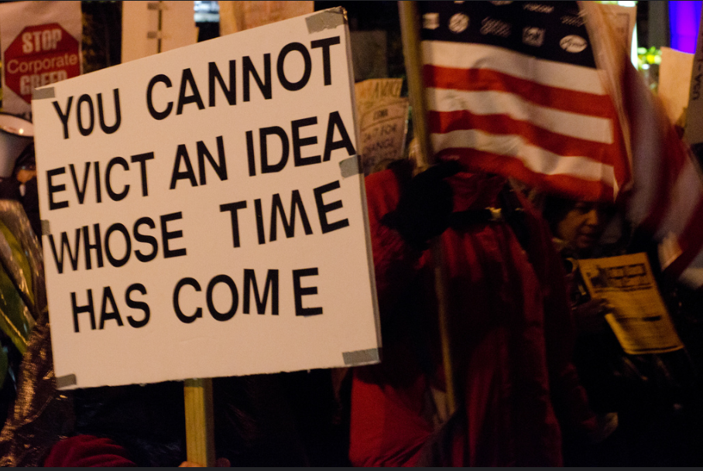
Democratic Ideals
The idea of democracy is easier, than the practice of democracy
Image: “You cannot evict an idea whose time has come” by Tim Pierce. CC BY

Slide 11
Democratic Ideals: Freedoms
The state needs to support this freedom, but not support one particular type of religion
Freedom of Religion is important.

Slide 12
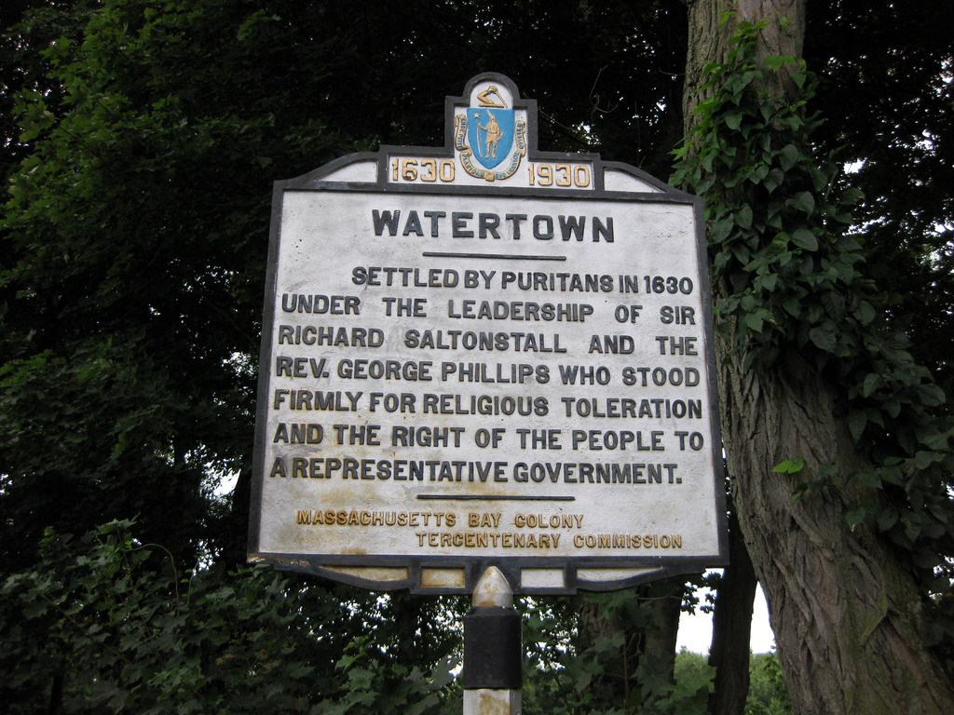
Toleration
Toleration and related issues important to democratic freedom.
Image: Watertown by Elizabeth Thomsen. CC BY-NC-SA

Slide 13
Religious Freedom
The Puritans fled England to the American Colonies for religious freedom
Many Supreme Court cases have dealt with Freedom of Religion

Slide 14
Freedom of Religion in Canada
The Canadian Charter of Rights and Freedom protects Freedom of Religion
Freedom of Religion is a fundamental freedom in Canada

Slide 15
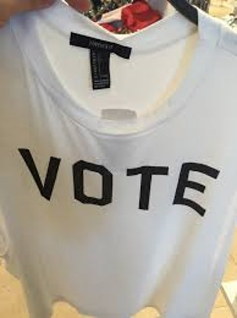
Democracy & Electoral Systems
Common electoral systems:
First-Past-the-Post
Proportional
Mixed system
Image: “Vote Shirt” by Janni Aragon. CC BY

Slide 16
First Past the Post
Often referred to as winner takes all
The candidate who wins the majority, wins all

Slide 17
Proportional Representation
Proportional system refers to when the parties are allocated seats based on the outcome of the election.
If the Green Party wins 7% of the vote, they earn 7% of the legislative seats

Slide 18
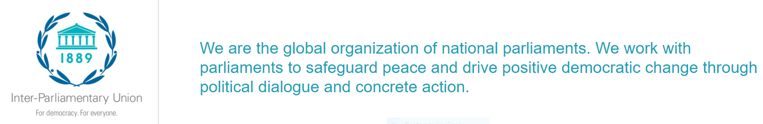
Inter-Parliamentary Union (IPU)
The IPU is a great resource for information on parliamentary systems and leaders
Image: By the Inter-Parliamentary Union. Not under a Creative Commons licence.

